Slide 1

AMSTer : SAR & InSAR Automated Mass processing Software for Multidimensional Time series
Nicolas d’Oreye^{1,2}, Dominique Derauw^{3,4}, Sergey Samsonov⁵,
Delphine Smittarello¹, Maxime Jaspard¹, Gilles Celli¹
ndo@ecgs.lu
amster@ecgs.lu
1 European Centre for Geodynamics and Seismology (ECGS), 19 rue Josy Welter, L-7256 Walferdange, Luxembourg
2 National Museum of Natural History (NMNH), 19 rue Josy Welter, L-7256 Walferdange, Luxembourg
3 Centre Spatial de Liège (CSL), Avenue du Pré Aily, B-4031 Angleur, Belgium
4 SAREOS, 1 Rue des Violettes, 4557 Fraiture, Belgium
5 Canada Centre for Mapping and Earth Observation, Natural Resources Canada (NRCAN), 560 Rochester Street, Ottawa, ON K1A 0E4, Canada

Slide 2
Summer School in InSAR, time series processing and deformation modelling
Automatization using cron jobs
Nicolas d’Oreye

Slide 3
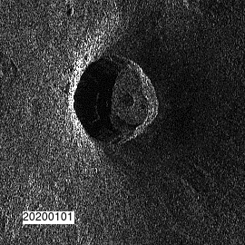

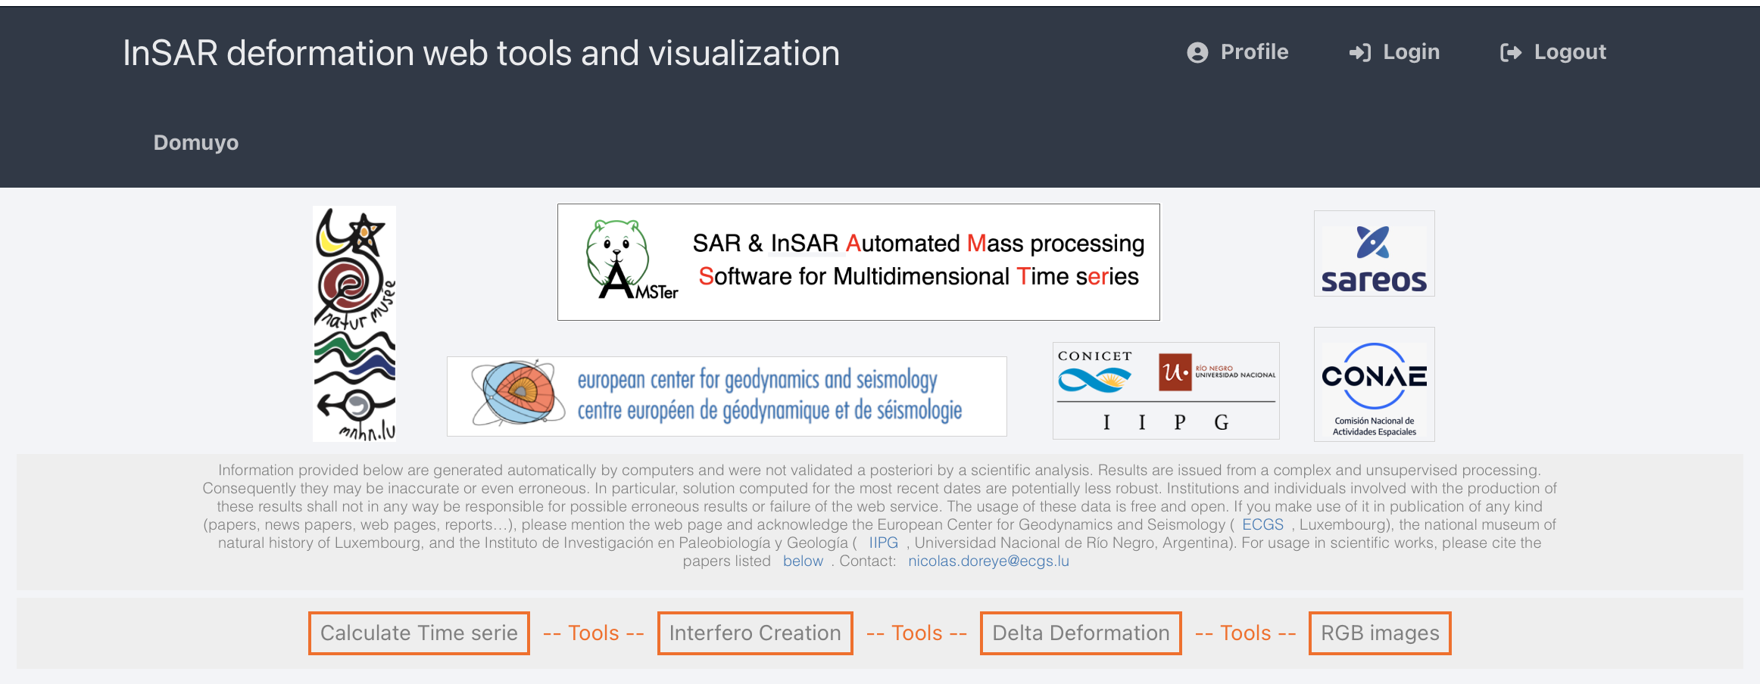
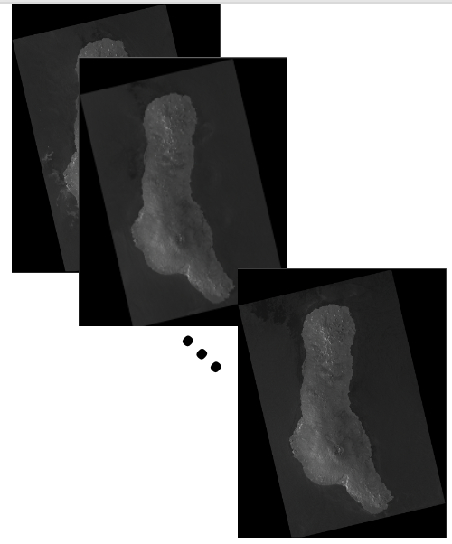
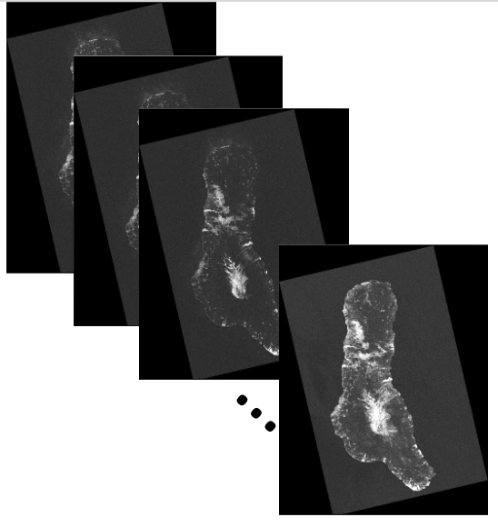
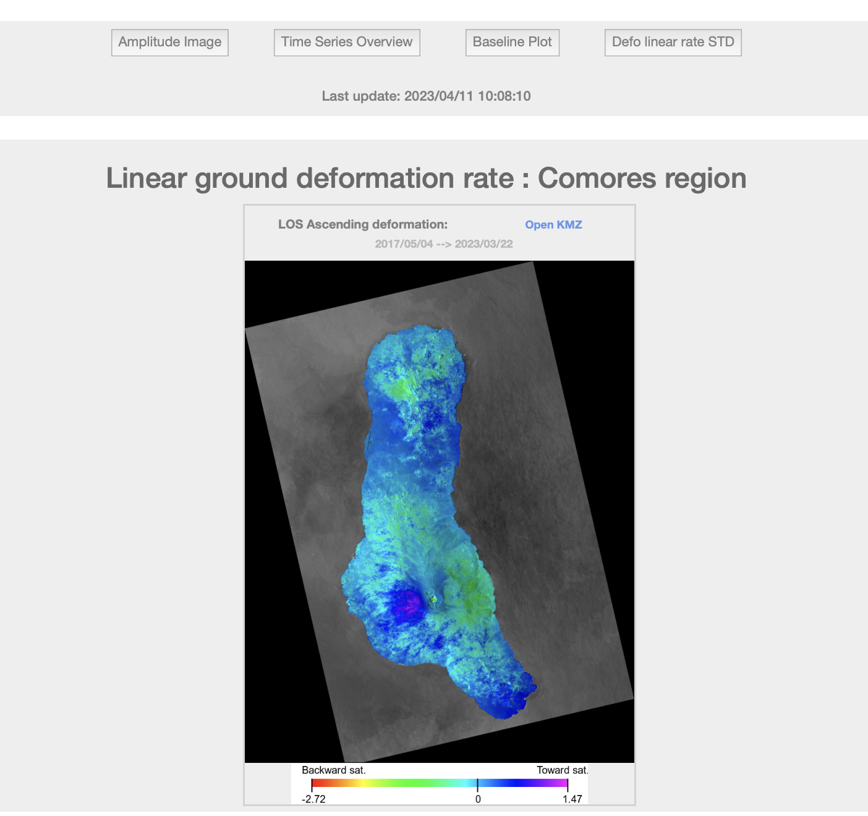
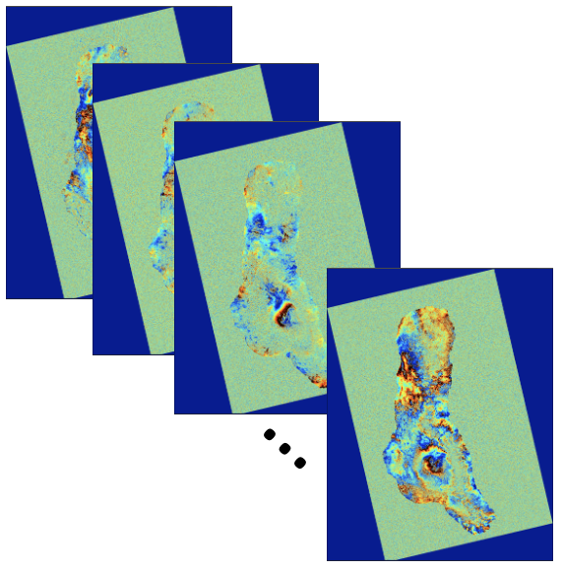
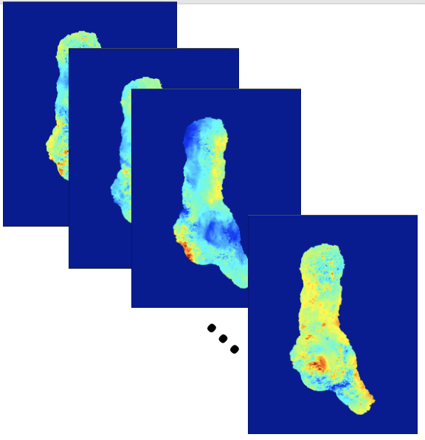
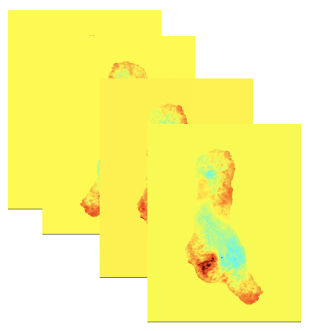
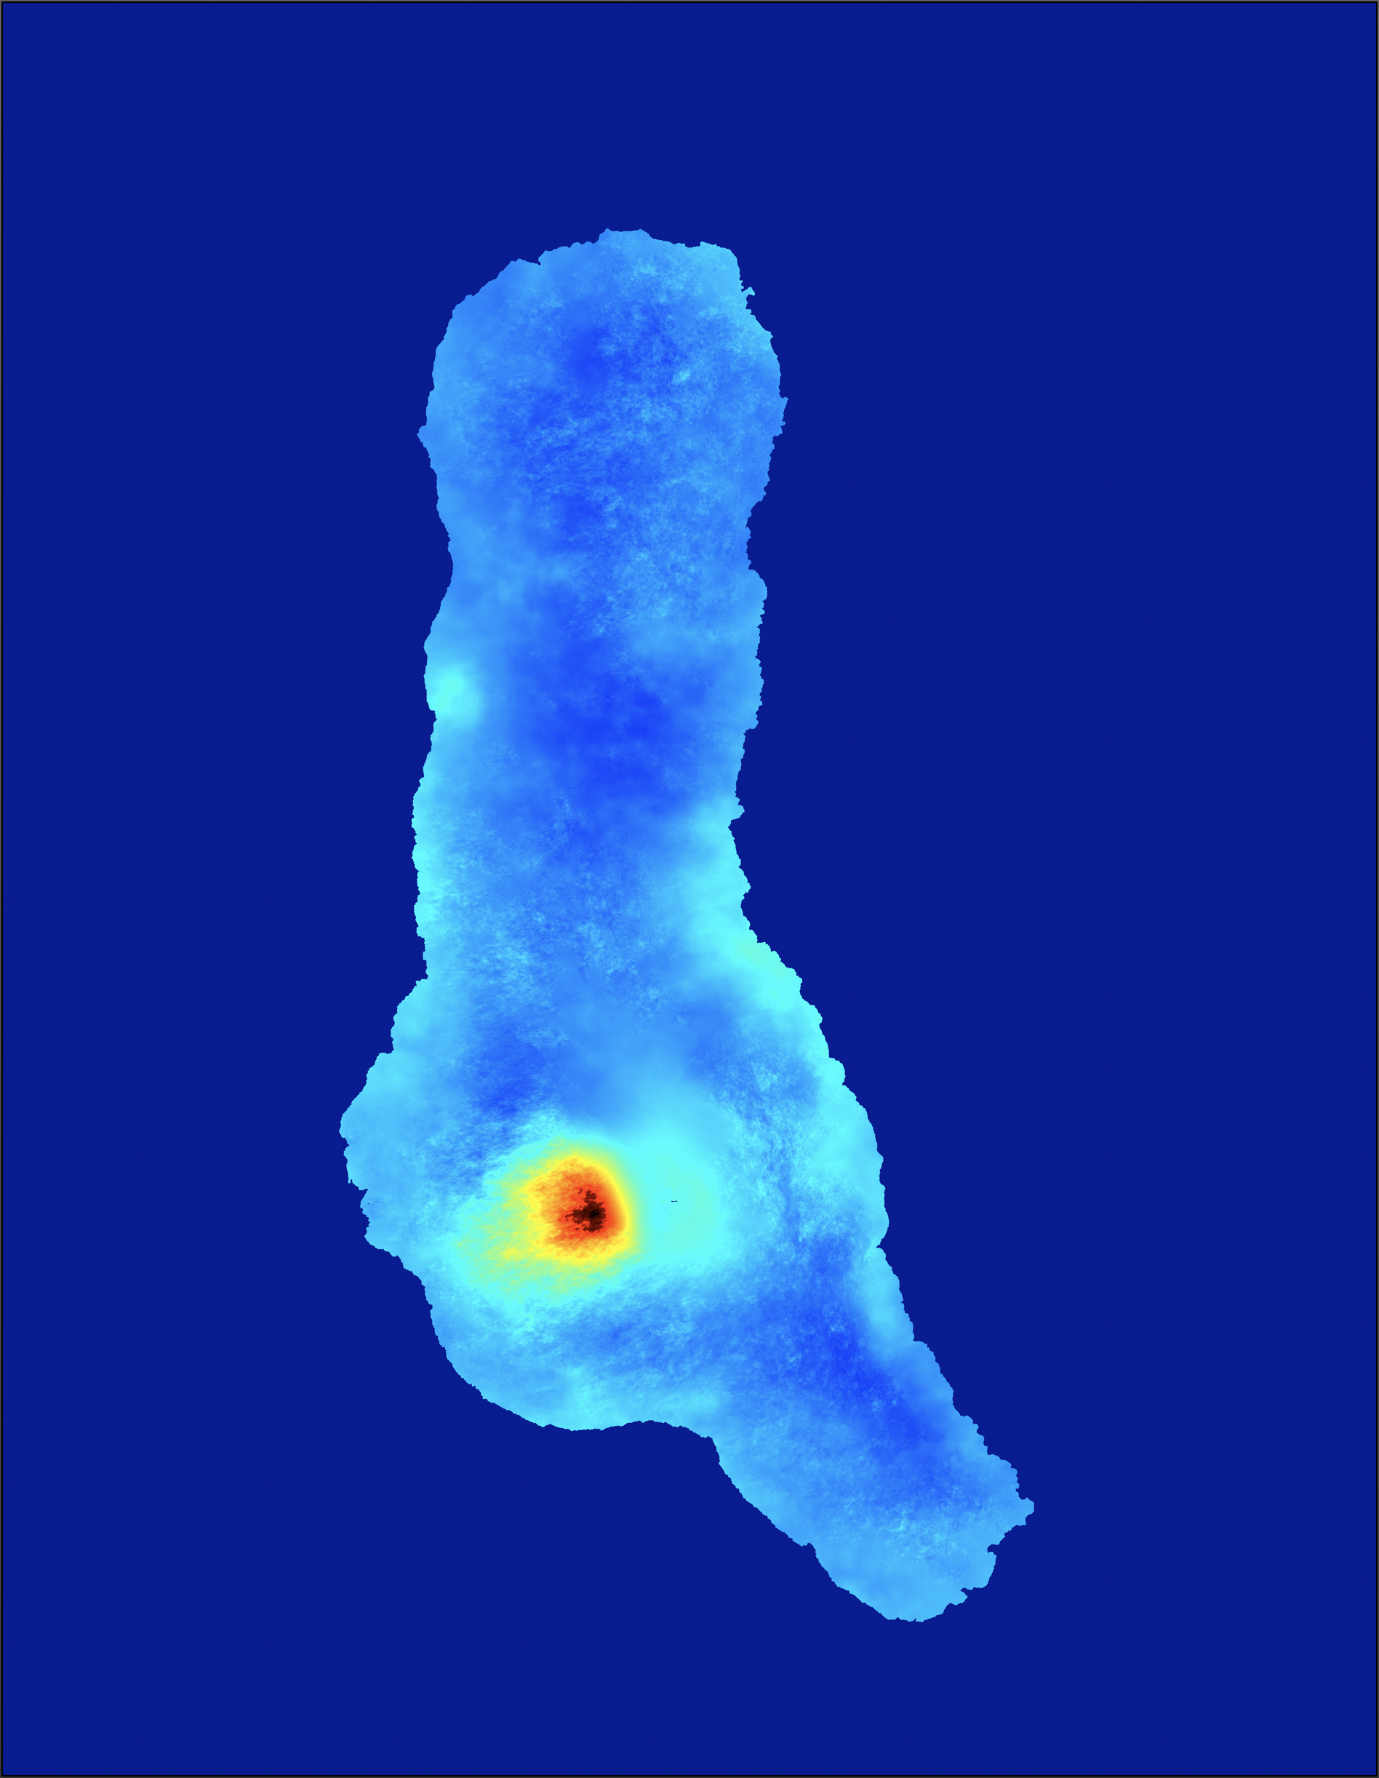
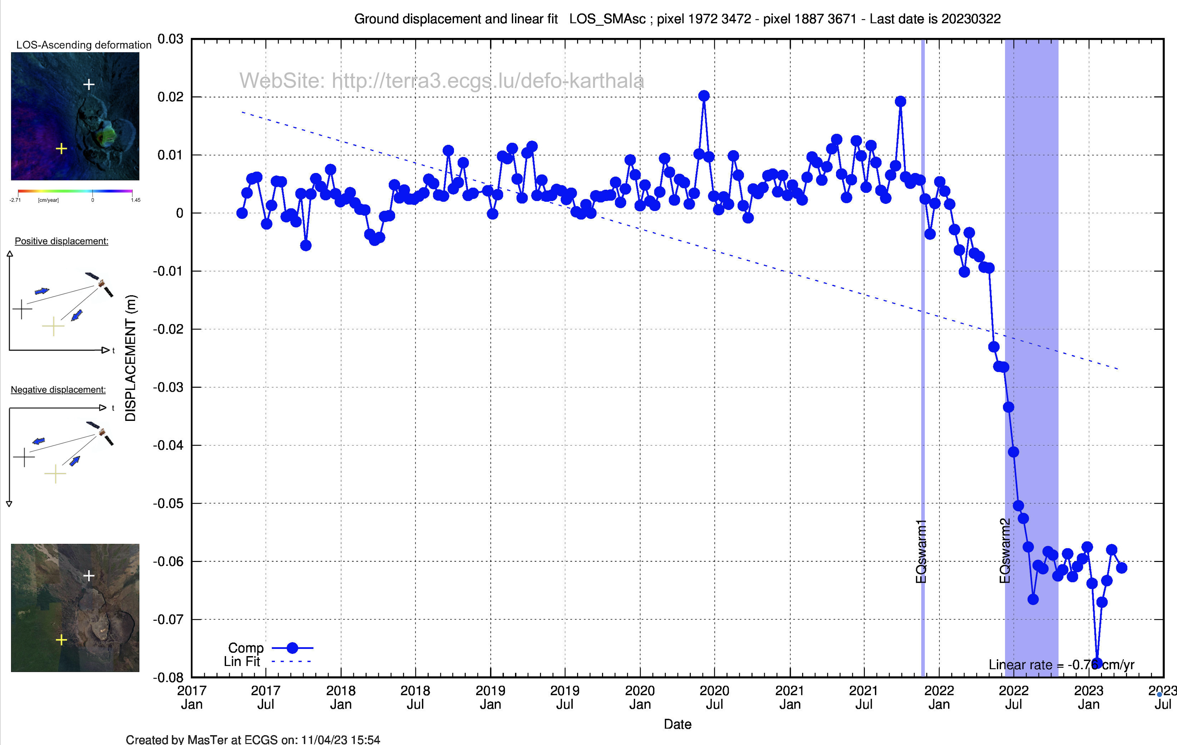
MasTer Toolbox
Sat. image
Download
Web Page(s)
Interferometric processing
(AMSTer Engine)
Ampli.
Coh.
Time Series processing
(MSBAS)
Ampli.
Defo.
Mean Veloc.
Interf.
Cumul. defo.
Defo.
Time series
G. Celli
D. Derauw
S. Samsonov
M. Jaspard
N. d’Oreye & D. Smittarello

Slide 4
Automatization using cron jobs
Plan:
What is a cron job ?
Step 0: download the data
Step 1: Read, coregister on Global Primary (Super Master) and compute baseline plots
Step 2: Process all the DInSAR pairs
Step 3: Run the MSBAS inversion
SAR shadow processing

Slide 5
Automatization using cron jobs
What is a cron job ?
Cron is a Linux-based program (daemon) allowing scheduling tasks at a specific time.
The cron jobs are the tasks launched by the cron
The crontab is the list of scheduled tasks and their execution time/repetition rate
You can see the planned tasks by launching in $HOME (with administrator rights) crontab -l (“l” stands for “list”)
You can edit (using your default editor) the crontab by launching in $HOME (with administrator rights) crontab -e (”e” stands for “edit”)
Syntax of the cron:
Line starting by # are comments
Scheduller: mm hh DoM MM DoW path/Task.sh where mm, hh, DoM, MM and DoW are resp. the minutes, hours, day of Month, Month, Day of Week (Sunday=0)
It might be wise to end the line with “> /dev/null 2>&1“ to avoid overloading the mailbox with possible messages generated by the task

Slide 6
Automatization using cron jobs
What is a cron job ?
In $HOME/SAR/AMSTer/SCRIPTS_MT/_cron_scripts[_NEW]/ you can find examples of cron scripts used to run AMSTer in a fully automatic mode for different targets:
VVP
Argentina
Comores
Guadeloupe
All the scripts were tuned to our needs at ECGS and may differ depending on the targets.
They are all split in the following steps
Download
Reading, coregistering and computing baseline plots
Mass processing of the interferograms and deformation maps
MSBAS inversion and time series plots for some sets of pre-defined point of interest
They are provided for inspiration and need to be strongly adapted to your own needs. We will illustrate it with Domuyo area.
Reunion Island
Luxembourg
Hawaii
Etc…

Slide 7
Automatization using cron jobs
What is a cron job ?
Step 0: download the data
Procedure depends on the satellite and the provider
There is an example of script by Gilles Celli for downloading S1 data from SciHub in $HOME/SAR/AMSTer/SCRIPTS_MT/_cron_scripts/_Download_Sentinel/sentinel1_download_all.sh which launch sentinel1_downloader_ingestiondate.sh. Both scripts must be adapted to your needs (set your password and login, change the e-mail addresses, adapt to your targets...).
Must be set in your crontab as e.g. (for being launched every day at 2h18 am): 18 02 * * * $HOME/SAR/AMSTer/SCRIPTS_MT/_cron_scripts/_Download_Sentinel/sentinel1_download_all.sh > /dev/null 2>&1
Other scripts to download S1 images can be found from the Internet
See also e.g. S1DataDownloader from AMSTer Engine to do it without script

Slide 8
Automatization using cron jobs
What is a cron job ?
Step 0: download the data
Step 1: Read, coregister on Global Primary (Super Master) and compute baseline plots
See examples of crons step 1 in $HOME/SAR/AMSTer/SCRIPTS_MT/_cron_scripts/Domuyo_S1_Step1_Read_SMCoreg_Pairs.sh
It will process successively :
Read_All_Img.sh
[ _Check_ALL_S1_SizeAndCoord_InDir.sh. Explanation of that step: if an image has not the expected nr of bursts and corner’s coordinates (tolerance is hard coded in script) ➔ stores it in _TMP_QUARANTINE and it will try next time. ]
SuperMasterCoreg.sh (Asc and Desc at the same time in background - see “&” at the end of line till “wait”)
lns_All_Img.sh (Asc and Desc at the same time in background)
Prepa_MSBAS.sh (Asc and Desc at the same time in background)
[ Plot a common baseline plot for Asc and Desc modes with plot_Multi_BaselinePlot.sh ]
Note that it start the SuperMasterCoreg.sh before the Prepa_MSBAS.sh because it knows already the date of the Global Primary (Super Master)
Let’s see the script…

Slide 9
Automatization using cron jobs
What is a cron job ?
Step 0: download the data
Step 1: Read, coregister on Global Primary (Super Master) and compute baseline plots
Step 2: Process all the DInSAR pairs
See examples of crons step 1 in $HOME/SAR/AMSTer/SCRIPTS_MT/_cron_scripts/Domuyo_S1_Step2_MassProc.sh
It will process successively :
Check that no step 1 nor other step 2 processings are running for the same target
SuperMaster_MassProc.sh (Asc and Desc at the same time in background)
Let’s see the script…
If you need InSAR, MasTer it
Luxembourg, May 22-26, 2023

Slide 10
Automatization using cron jobs
What is a cron job ?
Step 0: download the data
Step 1: Read, coregister on Global Primary (Super Master) and compute baseline plots
Step 2: Process all the DInSAR pairs
Step 3: Run the MSBAS inversion
See examples of crons step 1 in $HOME/SAR/AMSTer/SCRIPTS_MT/_cron_scripts/Domuyo_S1_Step3_MSBAS.sh
It will process successively:
Prepare the required directories (if not done yet)
Prepare the list of points for which it will plot the time series
Check that no step 3 nor Mass Processing are running for the same target
Remove_Duplicate_Pairs_File_All_Modes_But_Ampl.sh: if a S1 orbit is updated, products are re-computed and may have a slighly different Bp or Ha or Incidence angle and hence another name. It remove the oldest.
Computes the date of the last Asc and Desc processed pair
Checks in a log file what was the date of the last processed pairs (Asc and Desc)
Remove Broken Links and Clean txt file in existing ${MSBASDIR}/DefoInterpolx2Detren1 & 2 with Remove_BrokenLinks_and_Clean_txt_file.sh. Do the same in _Full 1 & 2_Full (cfr coherence threshold).
If same: STOP

Slide 11
Automatization using cron jobs
What is a cron job ?
Step 0: download the data
Step 1: Read, coregister on Global Primary (Super Master) and compute baseline plots
Step 2: Process all the DInSAR pairs
Step 3: Run the MSBAS inversion
It will process successively (continued):
Checks that each DefoInterpolx2Detrendi.txt has 4 columns (for files with and without coherence threshold).
_Check_bad_DefoInterpolx2Detrend.sh: Again remove lines in MODEi.txt files associated to possible broken links or duplicated lines
build_header_msbas_criteria.sh for preparing the MSBAS files
Update header.txt to our needs: R_FLAG (inversion order and lambda factor) and C_FLAG (no calib because defo is already detrended)
Check again MODEi.txt files (4 columns, no broken links, no duplicated lines…)
START the EW-UD processing without coherence threshold:
If not the first run, merge newly created DefoInterpolx2Detrendi.txt with DefoInterpolx2Detrendi_Full.txt and /DefoInterpolx2Detrendi with /DefoInterpolx2Detrendi_Full
Update header.txt to our needs: takes the DefoInterpolx2Detrendi_Full.txt data sets

Slide 12
Automatization using cron jobs
What is a cron job ?
Step 0: download the data
Step 1: Read, coregister on Global Primary (Super Master) and compute baseline plots
Step 2: Process all the DInSAR pairs
Step 3: Run the MSBAS inversion
It will process successively (continued):
Run the MSBAS.sh for the Full data sets (i.e. without coherence threshold) with a list of points of interest for which it will compute the time series (pdf format, with error bars)
Make the baseline plots with exactly the pairs used: PlotBaselineGeocMSBASmodeTXT.sh
Copy the list of points of interest and the time series (plots and values as .txt; both named with description) in the directory where times series are stored for the _Full processing, that is /zz_UD_EW_TS_Auto_${ORDER}_${LAMBDA}_${LABEL}_NoCohThresh/
Plot additional times series, though as double difference bewteen points of interest using PlotTS_all_comp.sh (see next ppt)
Move these additional double difference time series (plots and values as .txt; both named with description) in the directory where times series are stored for the _Full processing, that is ${MSBASDIR}/zz_UD_EW_TS_Auto_${ORDER}_${LAMBDA}_${LABEL}_NoCohThresh/__Combi/ for figs, and ${MSBASDIR}/zz_UD_EW_TS_Auto_${ORDER}_${LAMBDA}_${LABEL}_NoCohThresh/_Time_series/ for values where ${MSBASDIR}/ is e.g. /3602/MSBAS/YourRegion_and_Some_Info/

Slide 13
Automatization using cron jobs
What is a cron job ?
Step 0: download the data
Step 1: Read, coregister on Global Primary (Super Master) and compute baseline plots
Step 2: Process all the DInSAR pairs
Step 3: Run the MSBAS inversion
It will process successively (continued):
START the EW-UD processing with coherence threshold:
Get back to header without DefoInterpolx2Detrendi_Full.txt data sets, that is DefoInterpolx2Detrendi.txt
Compute the coherence restriction: restrict_msbas_to_Coh.sh
If there are pairs to exclude: Exclude_Pairs_From_Mode.txt.sh
Run the MSBAS.sh with coherence threshold and with a list of points of interest for which it will compute the time series (pdf format, with error bars)
Make the baseline plots with exactly the pairs used: PlotBaselineGeocMSBASmodeTXT.sh
Copy the list of points of interest and the time series (plots and values as .txt; both named with description) in the directory where times series are stored for the processing with coh threshold, that is /zz_UD_EW_TS_Auto_${ORDER}_${LAMBDA}_${LABEL}/
Plot additional times series, though as double difference bewteen points of interest using PlotTS_all_comp.sh (see next ppt)

Slide 14
Automatization using cron jobs
What is a cron job ?
Step 0: download the data
Step 1: Read, coregister on Global Primary (Super Master) and compute baseline plots
Step 2: Process all the DInSAR pairs
Step 3: Run the MSBAS inversion
It will process successively (continued):
Move these additional double difference time series (plots and values as .txt; both named with description) in the directory where times series are stored for the _Full processing, that is ${MSBASDIR}/zz_UD_EW_TS_Auto_${ORDER}_${LAMBDA}_${LABEL}/__Combi/ for figs, and ${MSBASDIR}/zz_UD_EW_TS_Auto_${ORDER}_${LAMBDA}_${LABEL}/_Time_series/ for values
START the ASC processing with coherence threshold:
Set header.txt by commenting the line with DefoInterpolx2Detrend2.txt
Run the MSBAS.sh with coherence threshold and with a list of points of interest for which it will compute the time series (pdf format, with error bars)
Copy the list of points of interest and the time series (plots and values as .txt; both named with description) in the directory where times series are stored for the processing with coh threshold, that is /${MSBASDIR}/zz_LOS_TS_Asc_Auto_${ORDER}_${LAMBDA}_${LABEL}/
Plot additional times series, though as double difference bewteen points of interest using PlotTS.sh (see next ppt)

Slide 15
Automatization using cron jobs
What is a cron job ?
Step 0: download the data
Step 1: Read, coregister on Global Primary (Super Master) and compute baseline plots
Step 2: Process all the DInSAR pairs
Step 3: Run the MSBAS inversion
It will process successively (continued):
Move these additional double difference time series (plots and values as .txt; both named with description) in the directory where times series are stored for the _Full processing, that is ${MSBASDIR}/zz_LOS_TS_Asc_Auto_${ORDER}_${LAMBDA}_${LABEL}/__Combi/ for figs, and ${MSBASDIR}/zz_LOS_TS_Asc_Auto_${ORDER}_${LAMBDA}_${LABEL}/_Time_series/ for values
START the DESC processing with coherence threshold:
Set header.txt by commenting the line with DefoInterpolx2Detrend1.txt
Run the MSBAS.sh with coherence threshold and with a list of points of interest for which it will compute the time series (pdf format, with error bars)
Copy the list of points of interest and the time series (plots and values as .txt; both named with description) in the directory where times series are stored for the processing with coh threshold, that is /${MSBASDIR}/zz_LOS_TS_Desc_Auto_${ORDER}_${LAMBDA}_${LABEL}/
Plot additional times series, though as double difference bewteen points of interest using PlotTS.sh (see next ppt)

Slide 16
Automatization using cron jobs
What is a cron job ?
Step 0: download the data
Step 1: Read, coregister on Global Primary (Super Master) and compute baseline plots
Step 2: Process all the DInSAR pairs
Step 3: Run the MSBAS inversion
It will process successively (continued):
Move these additional double difference time series (plots and values as .txt; both named with description) in the directory where times series are stored for the _Full processing, that is ${MSBASDIR}/zz_LOS_TS_Desc_Auto_${ORDER}_${LAMBDA}_${LABEL}/__Combi/ for figs, and ${MSBASDIR}/zz_LOS_TS_Desc_Auto_${ORDER}_${LAMBDA}_${LABEL}/_Time_series/ for values
Nearly there…
Get back to original header.txt in preparation of next run
Store the date and time of end or processing in ${MSBASDIR}/_last_MSBAS_process.txt for check at next run
Store date of last Asc and last Desc pair computed in ${MSBASDIR}/_Last_MassProcessed_Pairs_Time.txt for check at next run
All done !
Let’s see the script…

Slide 17
Automatization using cron jobs
What is a cron job ?
Step 0: download the data
Step 1: Read, coregister on Global Primary (Super Master) and compute baseline plots
Step 2: Process all the DInSAR pairs
Step 3: Run the MSBAS inversion
SAR shadow processing
See examples of crons for automatic amplitude time series of the Nyiragongo and Nyamulagira regions in $HOME/SAR/AMSTer/SCRIPTS_MT/_cron_scripts/Nyigo_Nyam_Crater_S1_Read_AMPLI.sh
It will process successively :
Read_All_Img.sh
Run a ALL2GIF.sh for the Nyiragongo region in Asc and Desc and for the Nyamulagira region in Asc. The Nyamulagira is on the same frame of the Desc scenes used for the Nyiragongo. Hence no need to run that one twice.
Because both volcanoes are on the same Desc frame, a special script is launched to extract the required info: Shadows_S1_Nyam_Desc.sh
Let’s see the script…

Slide 18
Automatization using cron jobs
Plan:
What is a cron job ?
Step 0: download the data
Step 1: Read, coregister on Global Primary (Super Master) and compute baseline plots
Step 2: Process all the DInSAR pairs
Step 3: Run the MSBAS inversion
SAR shadow processing
- DONE ! -

